Slide 1
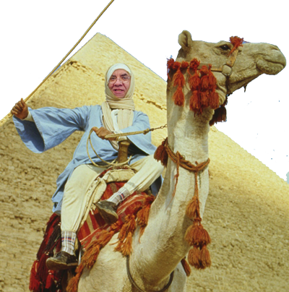
Nile River Shared
Secrets of the Egyptian Pyramids
Photodex
Presentation
Ancient Empires
DRJOE.CA
MP3
Files
Egyptian
TimeLine
Test 1 Film Review
Greek Crucible
PowerPoint
Presentations
Dr. J. Mior

Slide 2
How many sides did the Pyramids have?
Can modern technology be used to easily build a Pyramid today?
How long did it take to build the Pyramid?
Were the Pyramids earthquake proof?
Secrets of the Egyptian Pyramids

Slide 3
What were the Egyptian Kings known as?
What was the name of the first Egyptian King?
What was considered the Egyptian King’s lineage?
Egyptian TimeLine

Slide 4
Where did the Egyptians think the Nile came from?
The Nile River is the source of _____,_____,_______,_______.
Nile River: Shared or Monopolized?

Slide 5
Under whom did the Athenians initially live under?
Who was one of the most famous Greek Philosophers?
Greece had no main rivers? What main problem did this cause?
The Greeks: Crucible of Civilization

Slide 6
What is an Oligarchy?
Explain the conception of the constitution in Greek government.
What is a tyrant?
Who was Solon?
Know the name of the Greek gods.
Joe’s Photodex Presentation

Slide 7
Review PowerPoint presentations. (The majority of the questions will come from here).
Listen to MP3 Files (Audio version of PPT).
Review Movies
Course Web Page

